Slide 1
Supercharged Dijkstra’s
Computing ‘shortest’ paths on large road graphs in microseconds!
Payas Rajan
@PayasR

Slide 2
A graph is composed of
Nodes

Slide 3
A graph is composed of
Nodes
Edges

Slide 4
A graph is composed of…
Nodes
Edges
Edge Weights
Shown graph taken from Hannah Bast’s Route Planning lectures

Slide 5
We assume
No self loops
No parallel edges
All edge weights are positive integers

Slide 6
The Problem
Find shortest path between s and t

Slide 7
The (Real) Problem: Find shortest path on-
Nodes: 264,346
Edges: 733,846
Nodes: 321,270
Edges: 800,172
New York City
San Francisco Bay Area
NYC graph was extracted using Geoff Boeing’s OSMnx library and the Bay Area map was taken from Project OSRM and OpenStreetMaps.

Slide 8
Section 1: Dijkstra’s Algorithm

Slide 9
The 1959 paper

Slide 10
The 1959 paper

Slide 12
Relax the shortest edge incident to the frontier
Repeat till target ‘t’ found or we run out of nodes

Slide 13
Complexity

Slide 14
Demo 1: Bidirectional Dijkstra’s

Slide 15
Section 2: Contraction Hierarchies

Slide 16
In 2006…

Slide 17
Road network of Helsinki.
Height defined by speed limit value.
Created by Topi Tjukanov (@tjukanov)

Slide 18
Ideas that make CH work
Vertices can be ordered by their ‘importance’!

Slide 19
Ideas that make CH work
Vertices can be ordered by their ‘importance’!
2. SHORTCUTS!

Slide 20
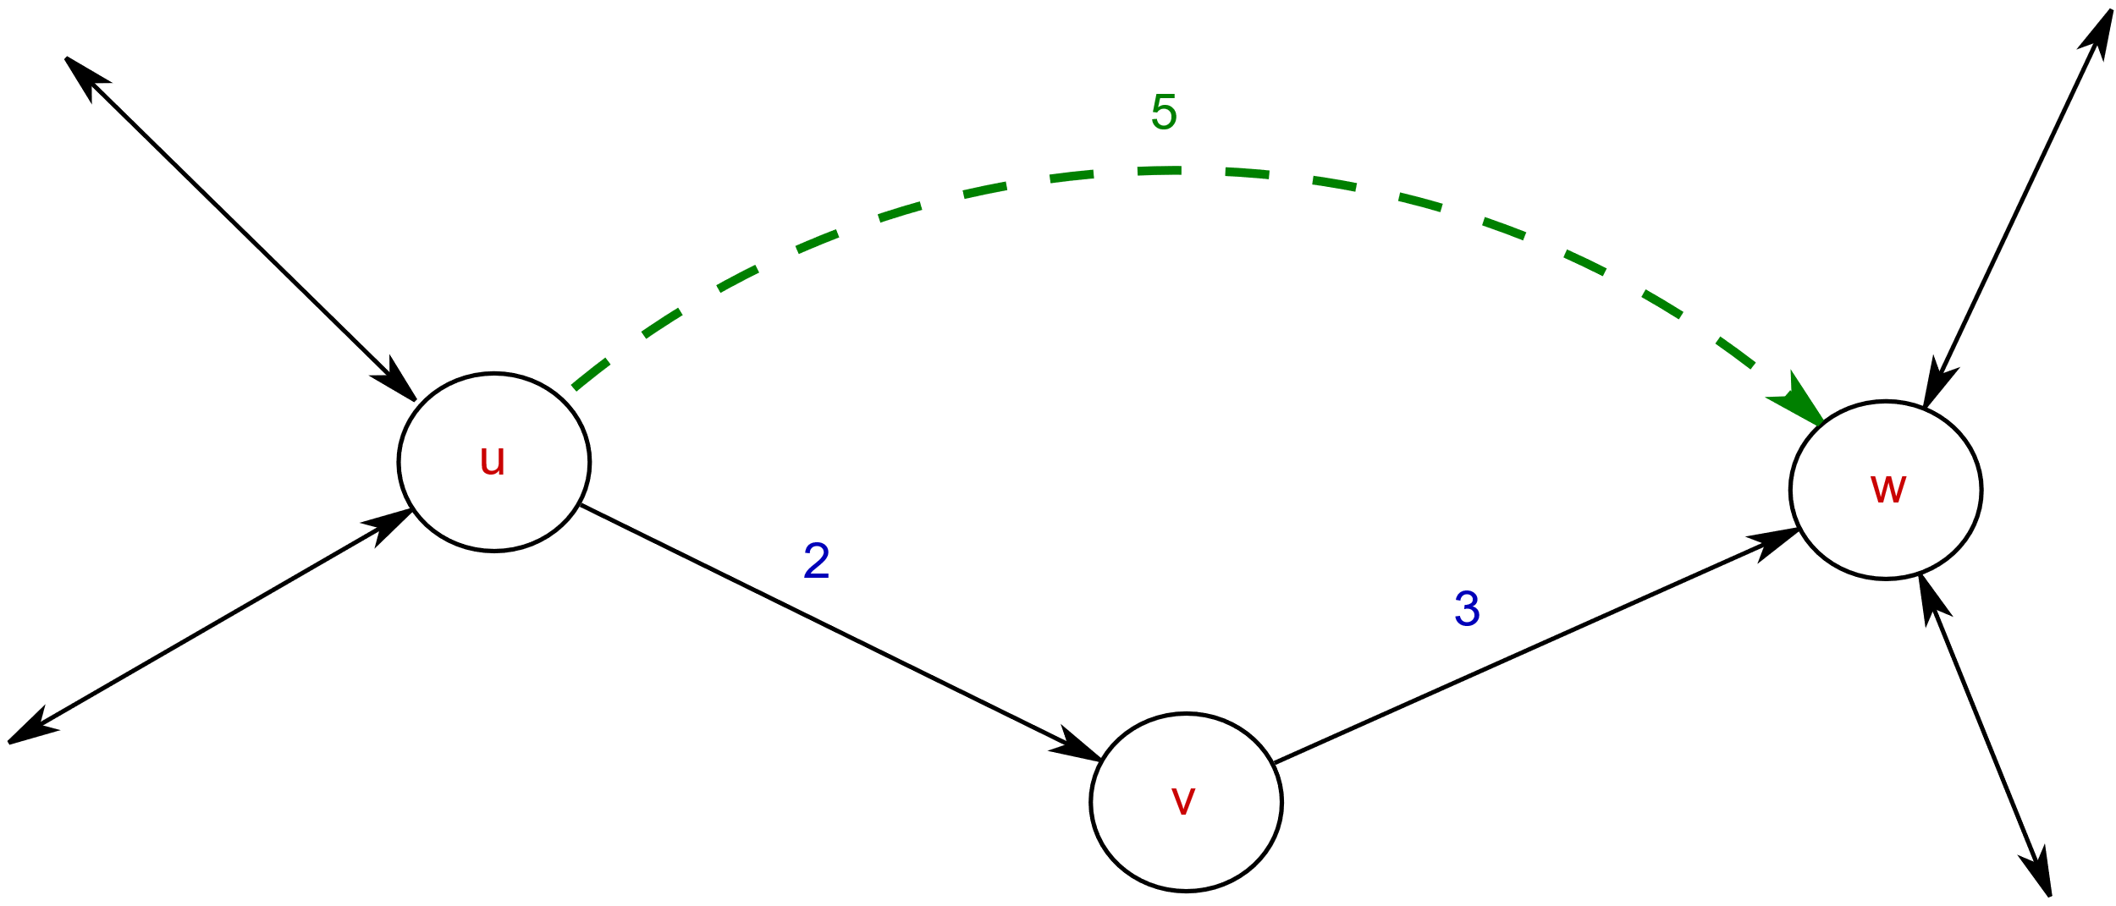
Ideas that make CH work
Vertices can be ordered by their ‘importance’!
SHORTCUTS!
If U->V->W
is the shortest path
from U to W,
add a shortcut U -> W!
(this is called the
‘contraction operation’)

Slide 21
Think about what we just did for a second…
We ADDED edges to the graph, and made it bigger…
in order to compute shortest paths faster!

Slide 22
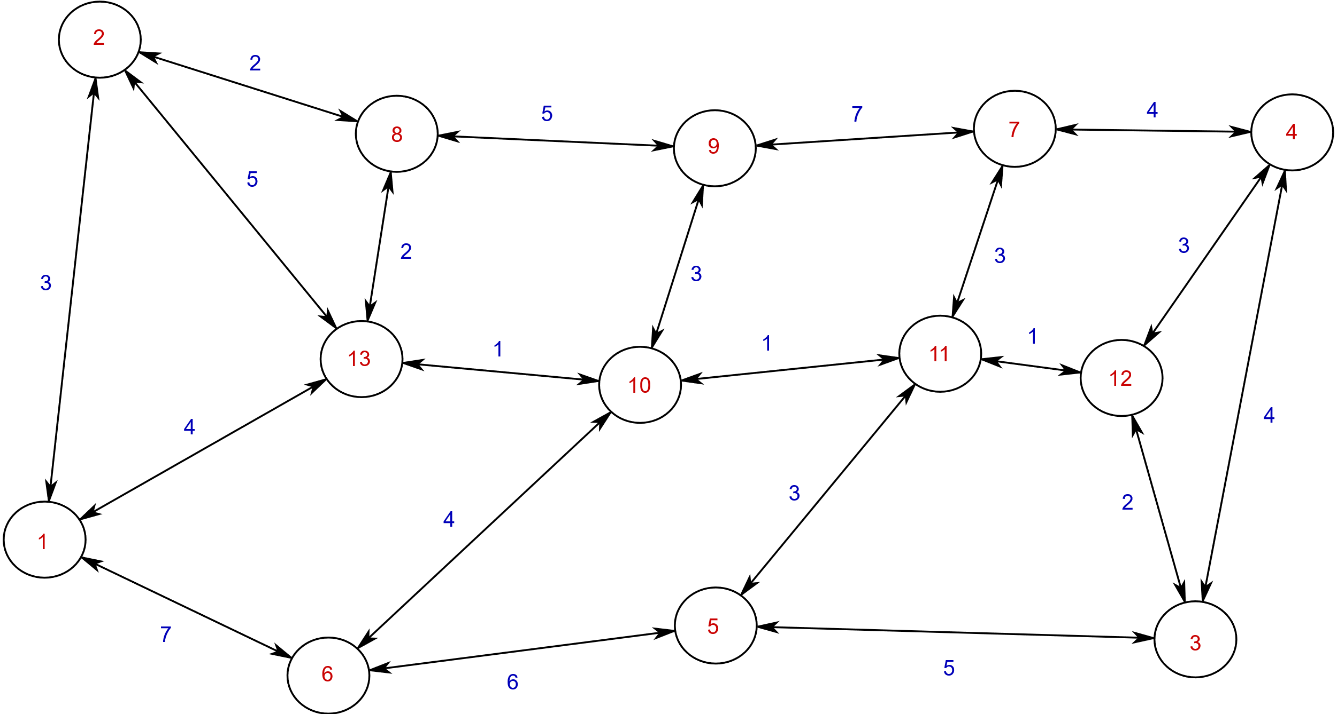

Slide 23
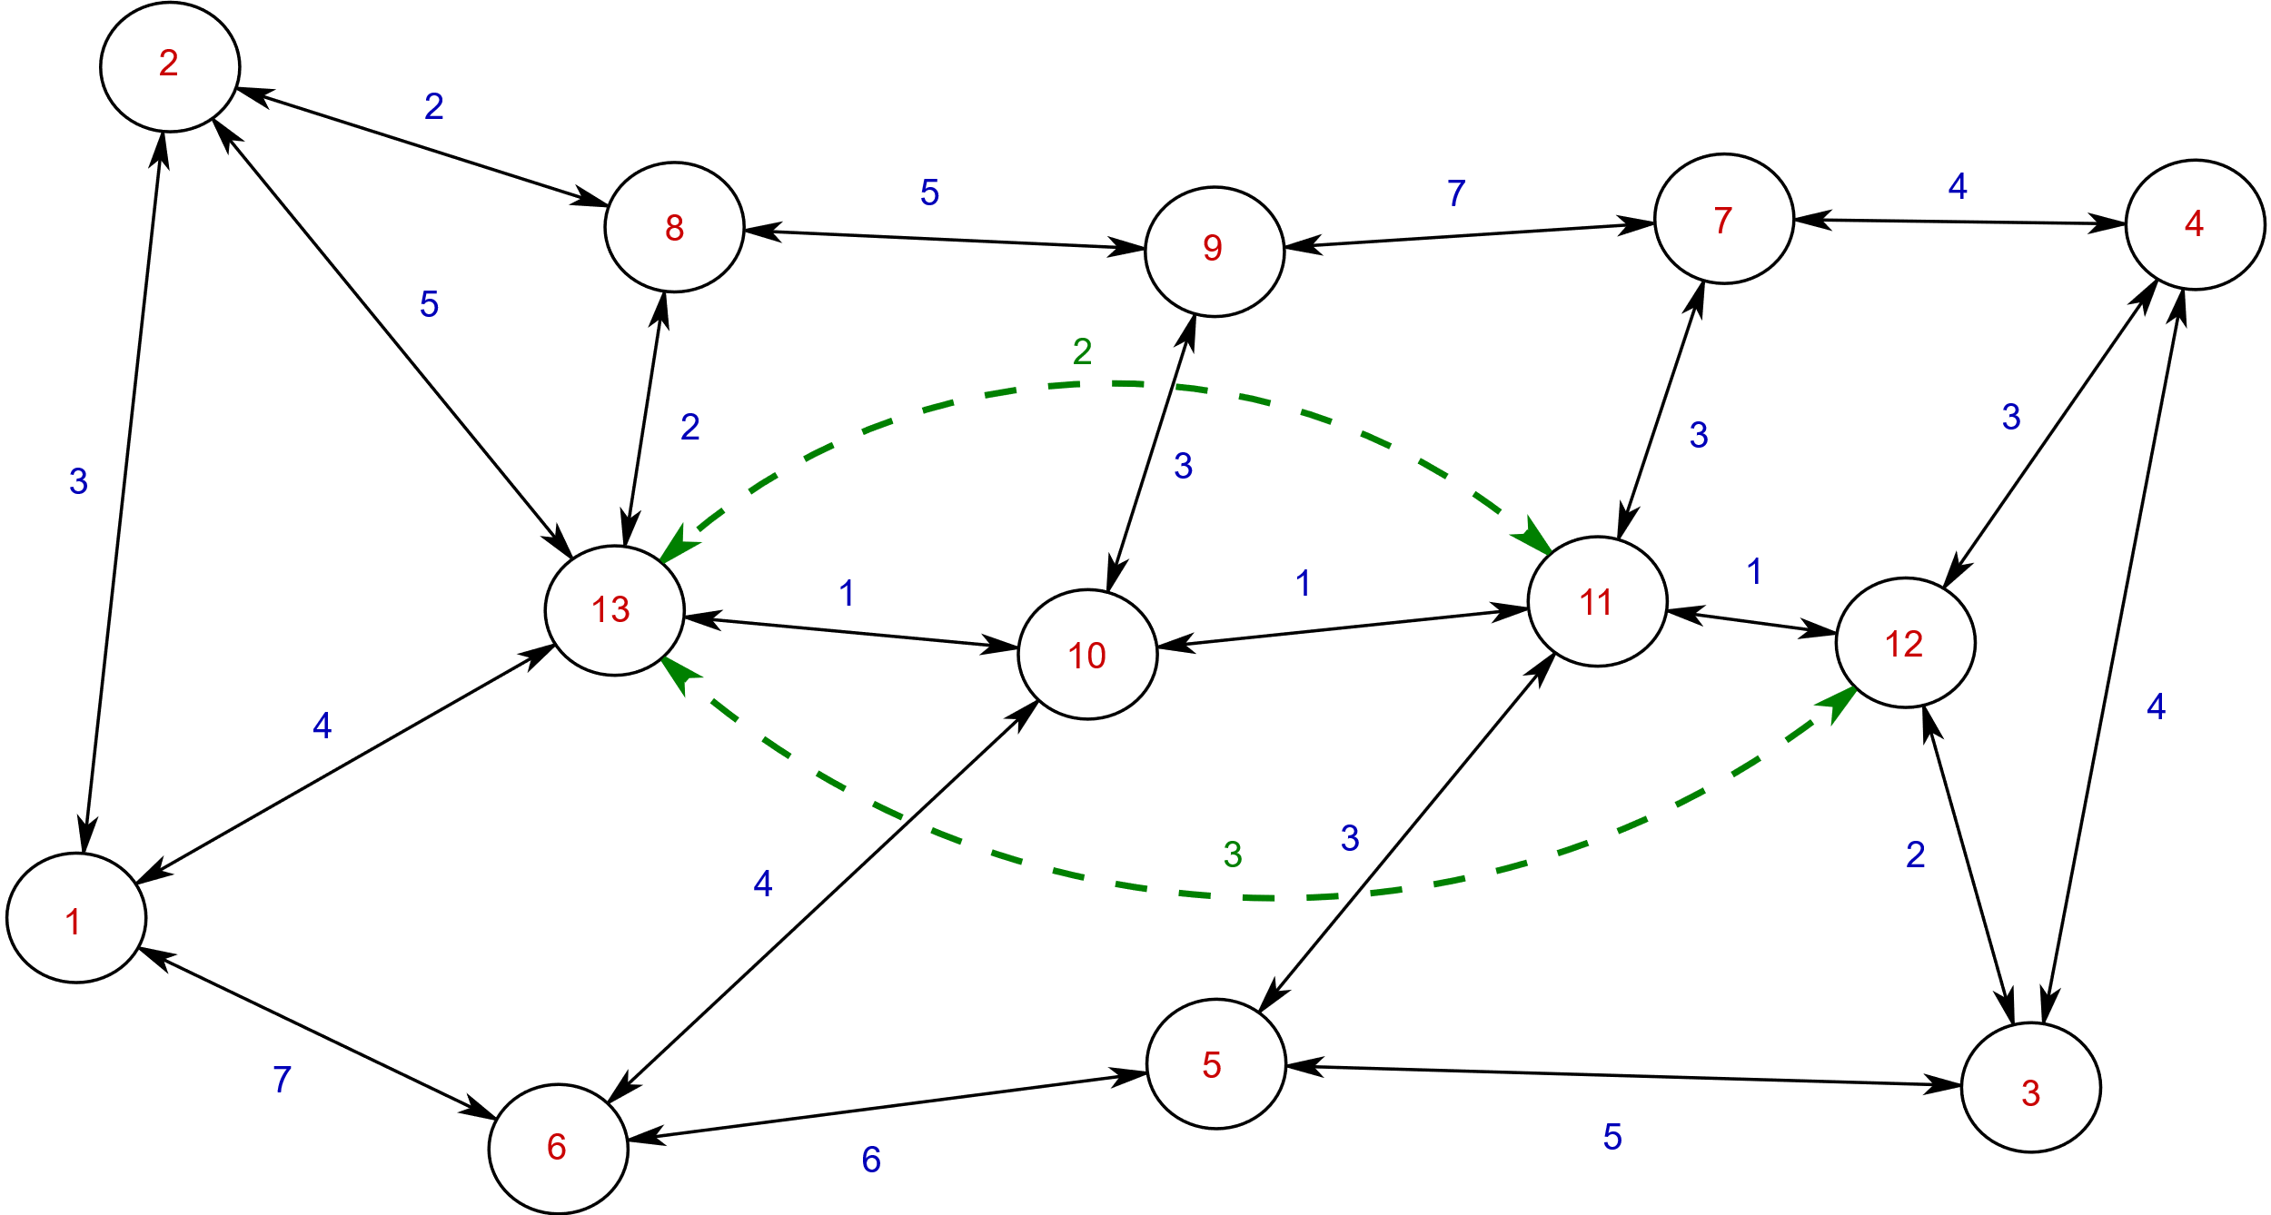

Slide 24
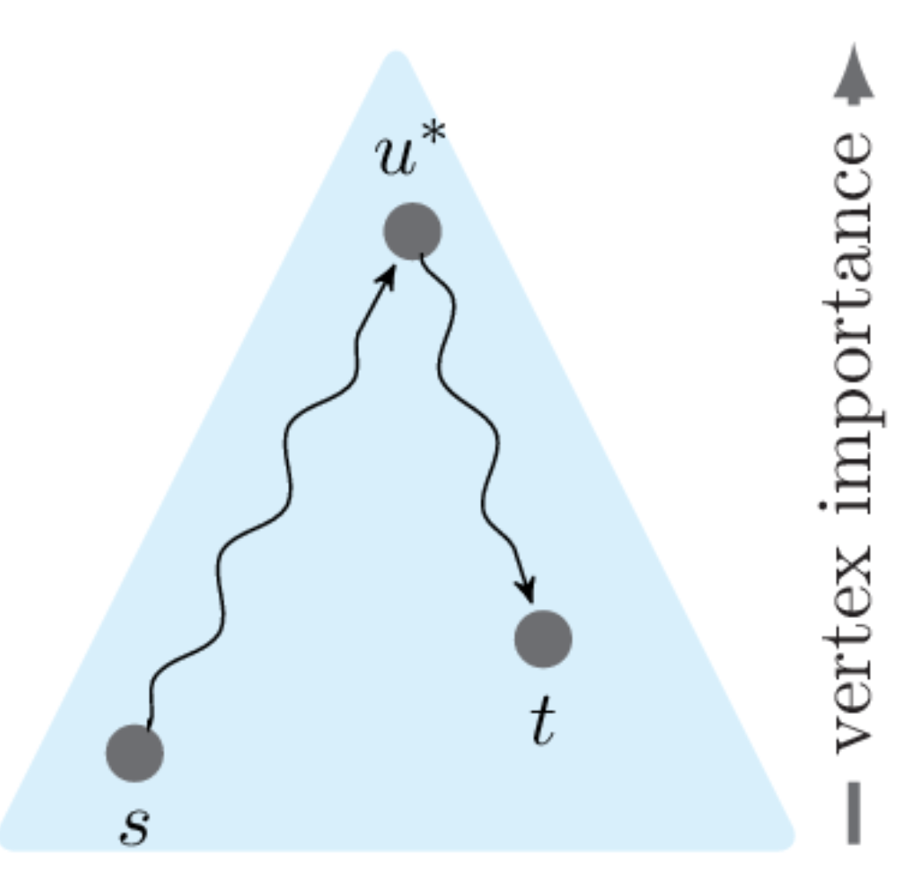
Image by Hannah Bast

Slide 25
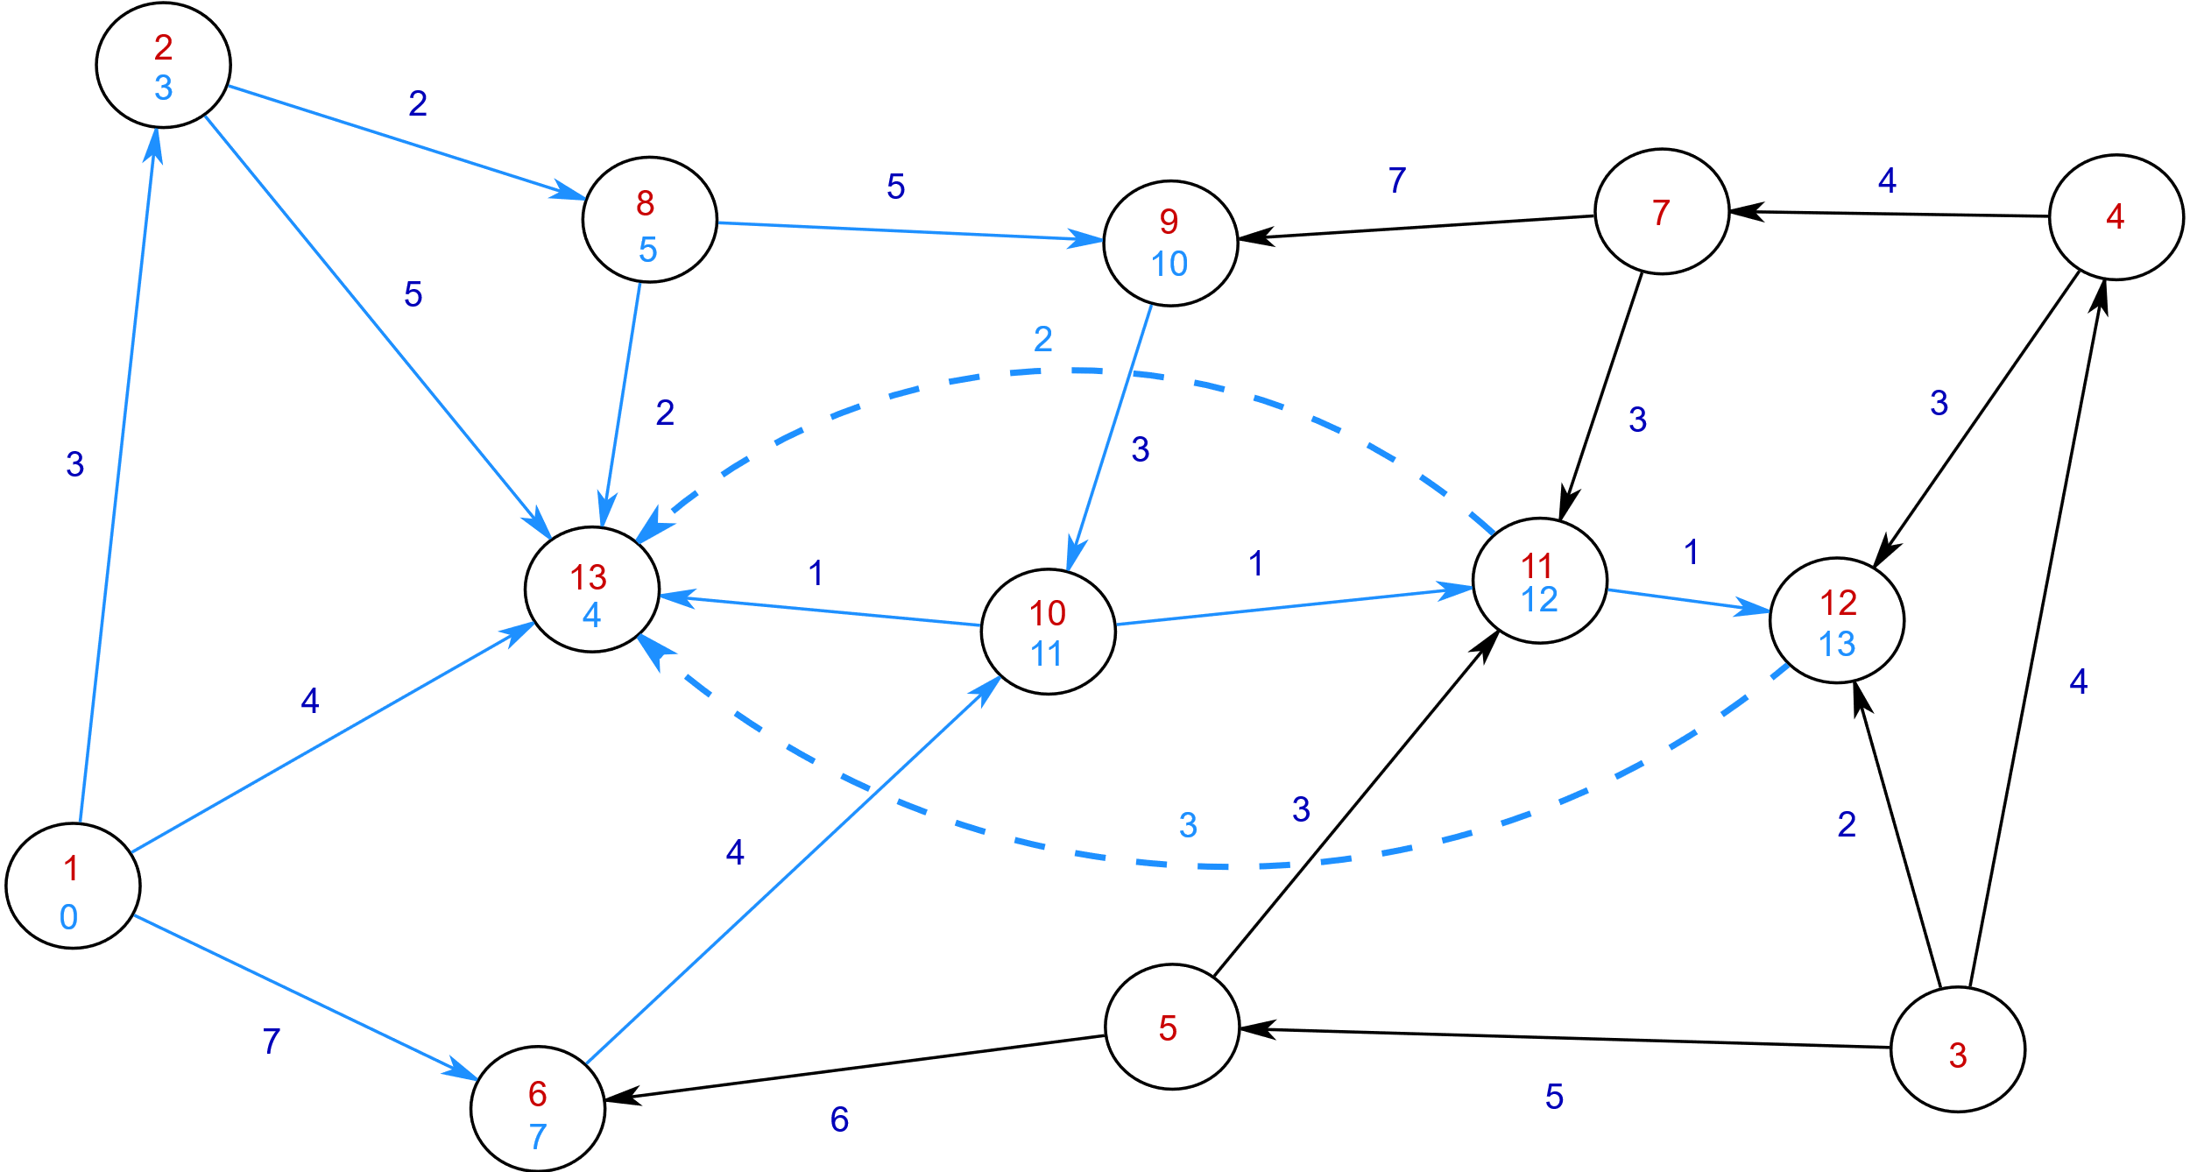

Slide 26
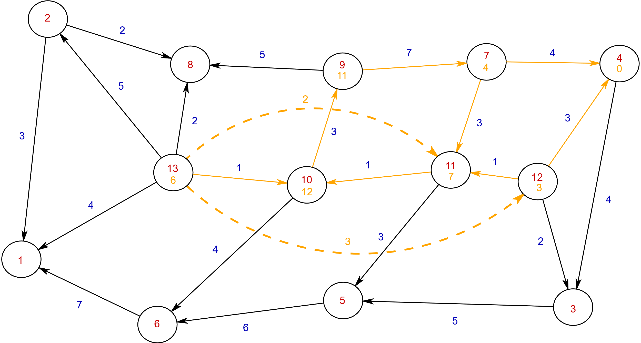

Slide 27
Considerations
In what order should the vertices be contracted? A: In increasing order of their ‘importance’.
How to determine importance of a vertex? A: In practice, we fast heuristics suffice.
Is there an ‘optimal’ CH? A: Yes, an optimal CH is one where we add minimum number of additional edges to the graph without affecting the performance of shortest path queries.

Slide 28
Demo: Contraction Hierarchies

Slide 29
References
Hannah Bast’s 2012 video lectures on route planning
Geisberger, Robert, et al. "Contraction hierarchies: Faster and simpler hierarchical routing in road networks." International Workshop on Experimental and Efficient Algorithms. Springer, Berlin, Heidelberg, 2008.

Slide 30
Linear time algorithm available*! *In Theory

Slide 31
In 2014..

