Slide 1
Implementing Fast Route Planning Algorithms in Rust
Payas Rajan
@PayasR

Slide 2

In 2015…
“Graphs are a bit awkward to construct in Rust because of Rust’s stringent lifetime and mutability requirements”
- Nick R. Cameron, Mozilla

Slide 3
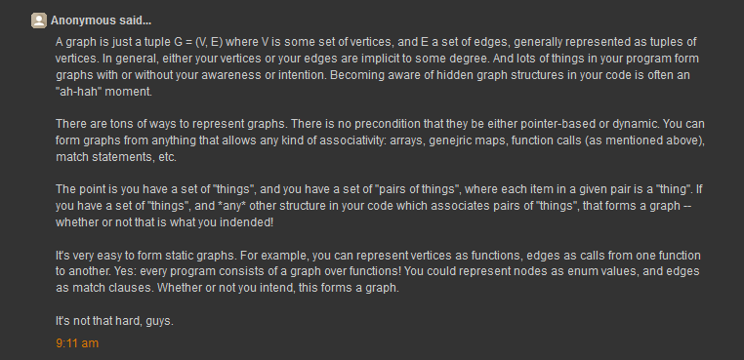
In 2015…
“It’s not that hard, guys.”
- Anonymous

Slide 4
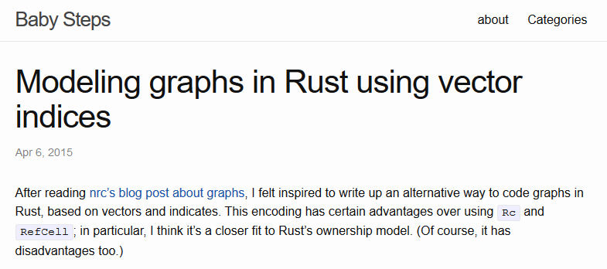
In 2015…

Slide 5
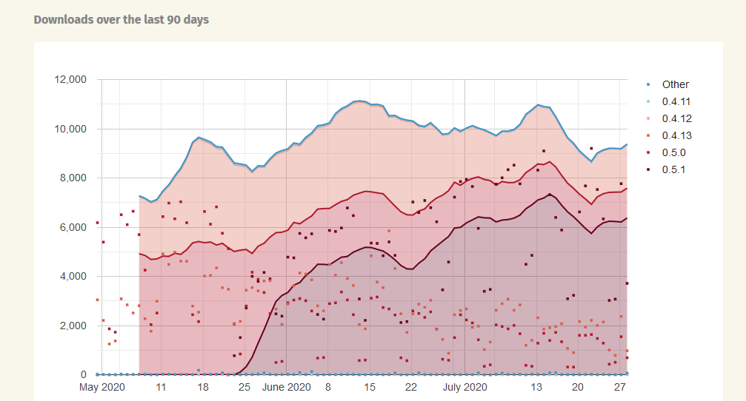
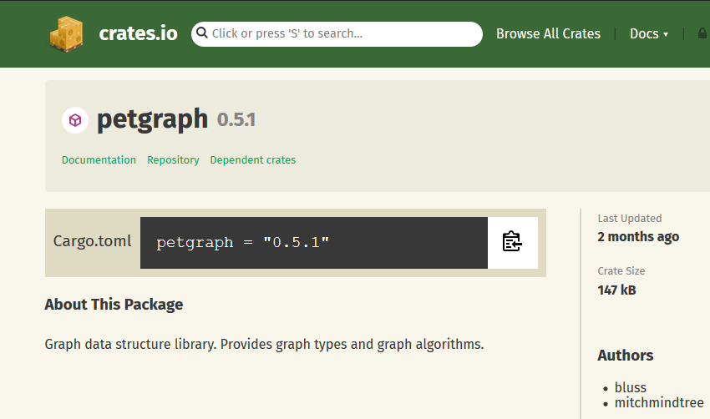

Where are we today?

Slide 6

A graph is composed of
Nodes

Slide 7
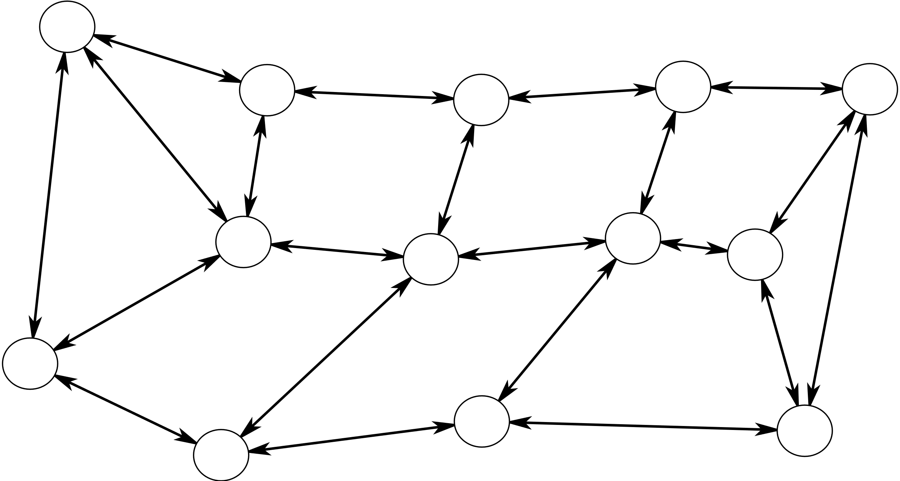
A graph is composed of
Nodes
Edges

Slide 8
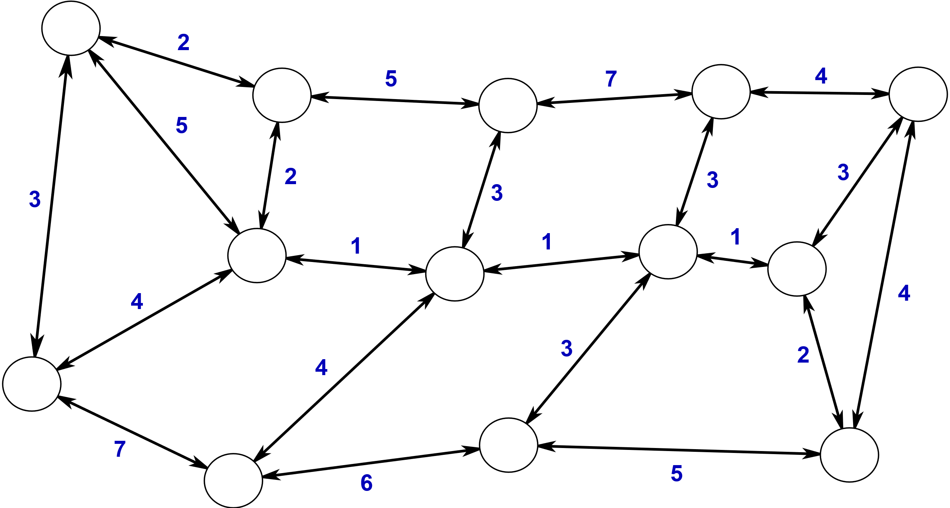
A graph is composed of…
Nodes
Edges
Edge Weights
Shown graph taken from Hannah Bast’s Route Planning lectures

Slide 9
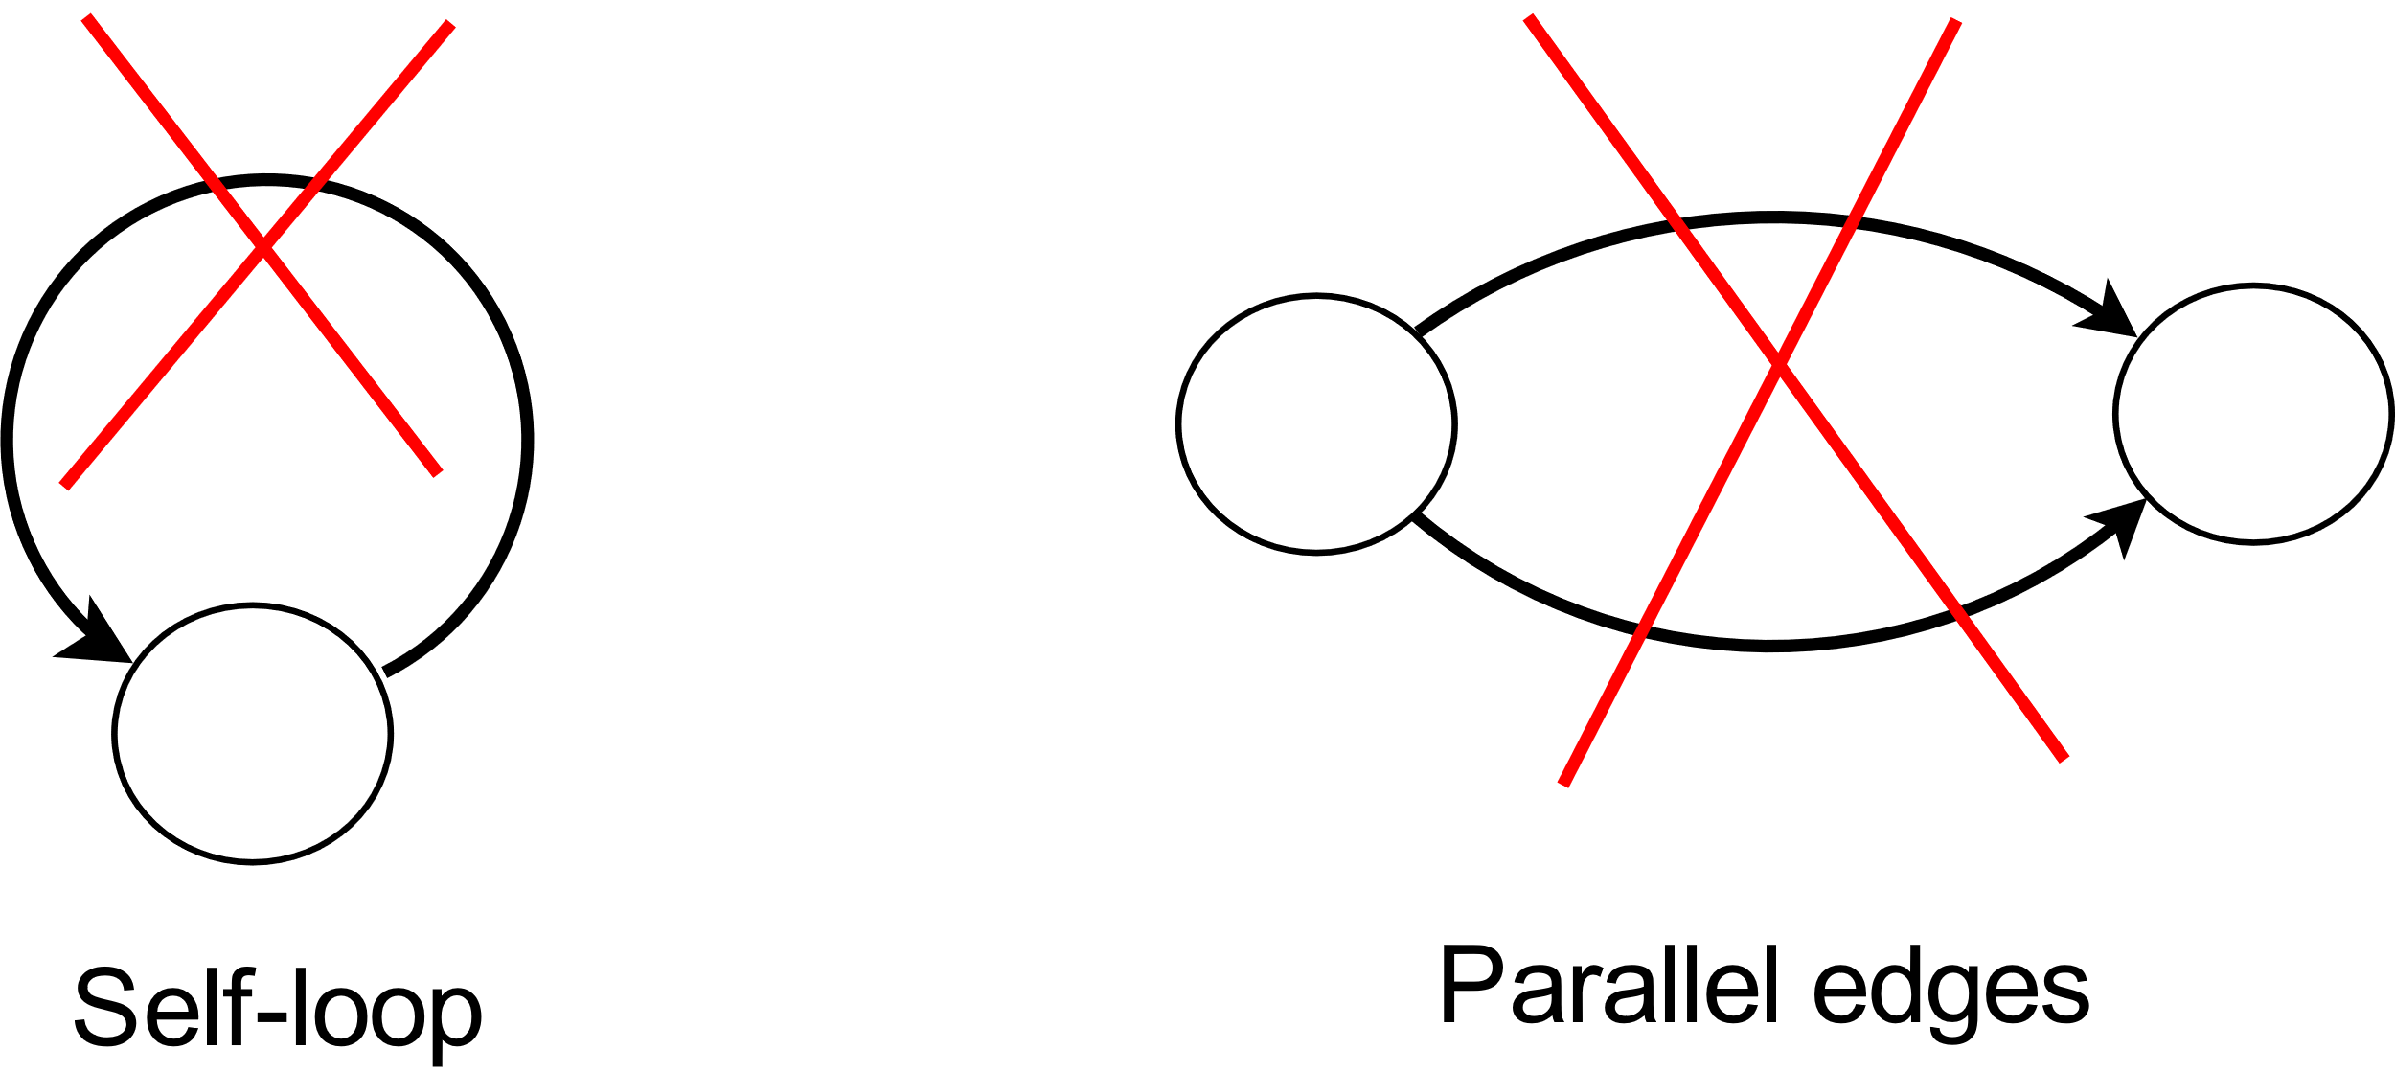
We assume
No self loops
No parallel edges
All edge weights are positive integers

Slide 10
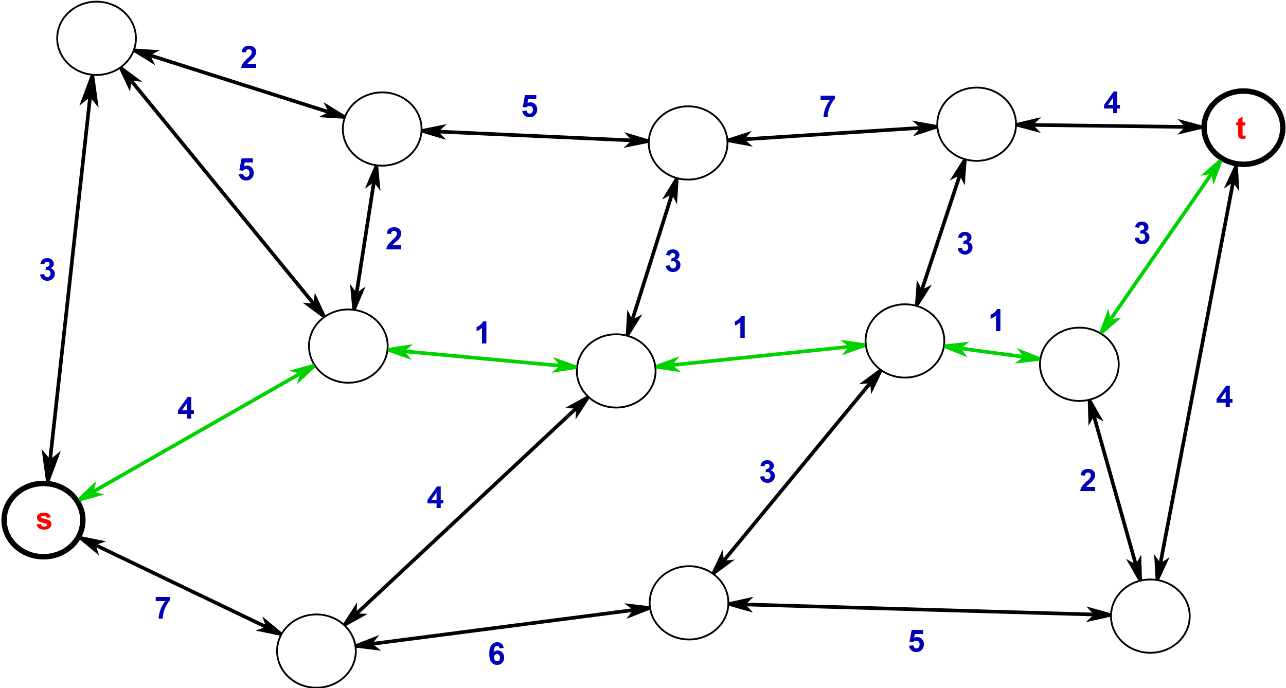
The Problem
Find shortest path between s and t

Slide 11


The (Real) Problem:
Find shortest path on-
Nodes: 264,346
Edges: 733,846
Nodes: 321,270
Edges: 800,172
New York City
San Francisco Bay Area
NYC graph was extracted using Geoff Boeing’s OSMnx library and the Bay Area map was taken from Project OSRM and OpenStreetMaps.

Slide 12
Section 1:
Dijkstra’s Algorithm

Slide 13
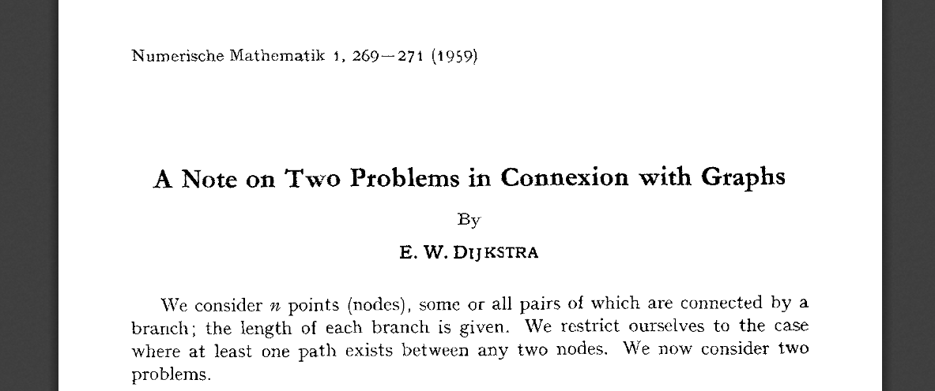
The 1959 paper

Slide 14
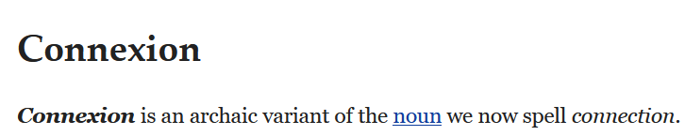
The 1959 paper

Slide 15
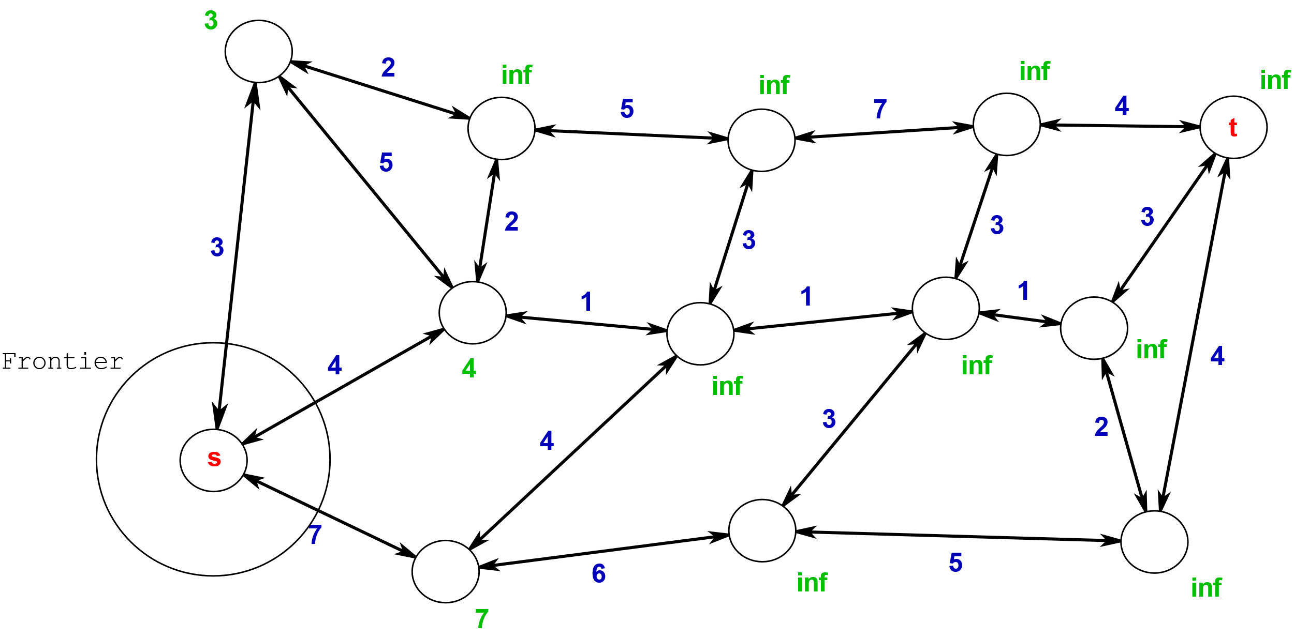

Slide 16
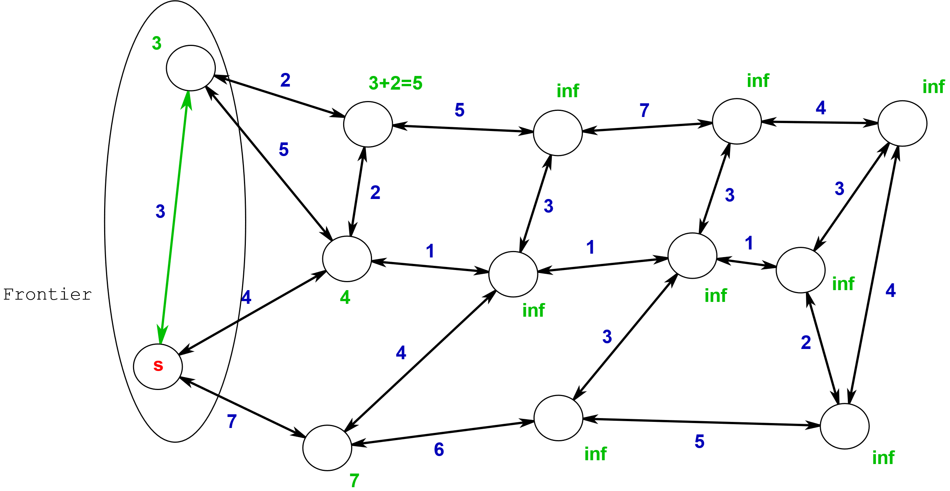
Relax the shortest edge incident to the frontier
Repeat till target ‘t’ found or we run out of nodes

Slide 17
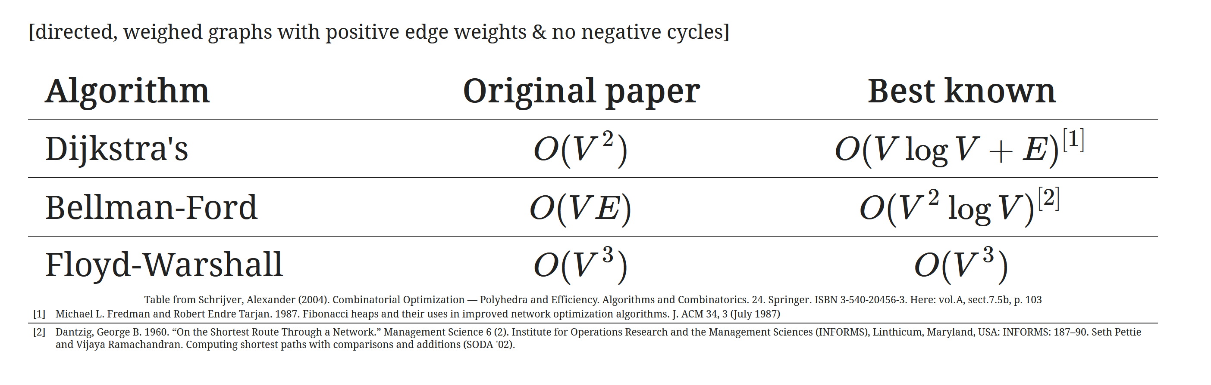
Complexity

Slide 18
Demo 1:
Bidirectional Dijkstra’s

Slide 19
Section 2:
Contraction Hierarchies

Slide 20

In 2006…

Slide 21
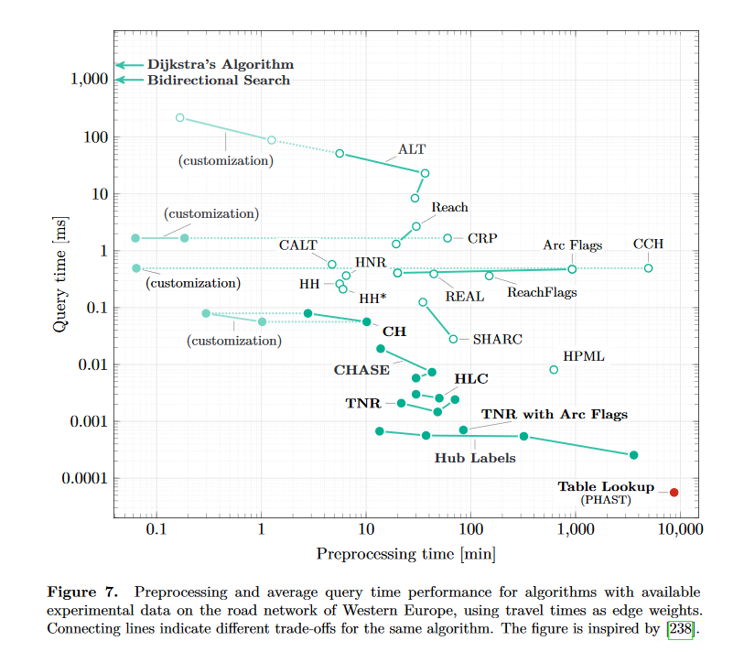
State of the Art
A wide variety of ‘speedup techniques’ are available today.
Tradeoff between preprocessing time and query time.
Image from https://arxiv.org/pdf/1504.05140.pdf

Slide 22

Road network of Helsinki.
Height defined by speed limit value.
Created by Topi Tjukanov (@tjukanov)

Slide 23
Contraction Hierarchies: Preprocessing
  Assign a scalar ‘importance’ to each vertex.

Slide 24
Contraction Hierarchies: Preprocessing
  Assign a scalar ‘importance’ to each vertex.
  Order the vertices in increasing order of ‘importance’.

Slide 25
Contraction Hierarchies: Preprocessing
  Assign a scalar ‘importance’ to each vertex.
  Order the vertices in increasing order of ‘importance’.
  SHORTCUTS!

Slide 26
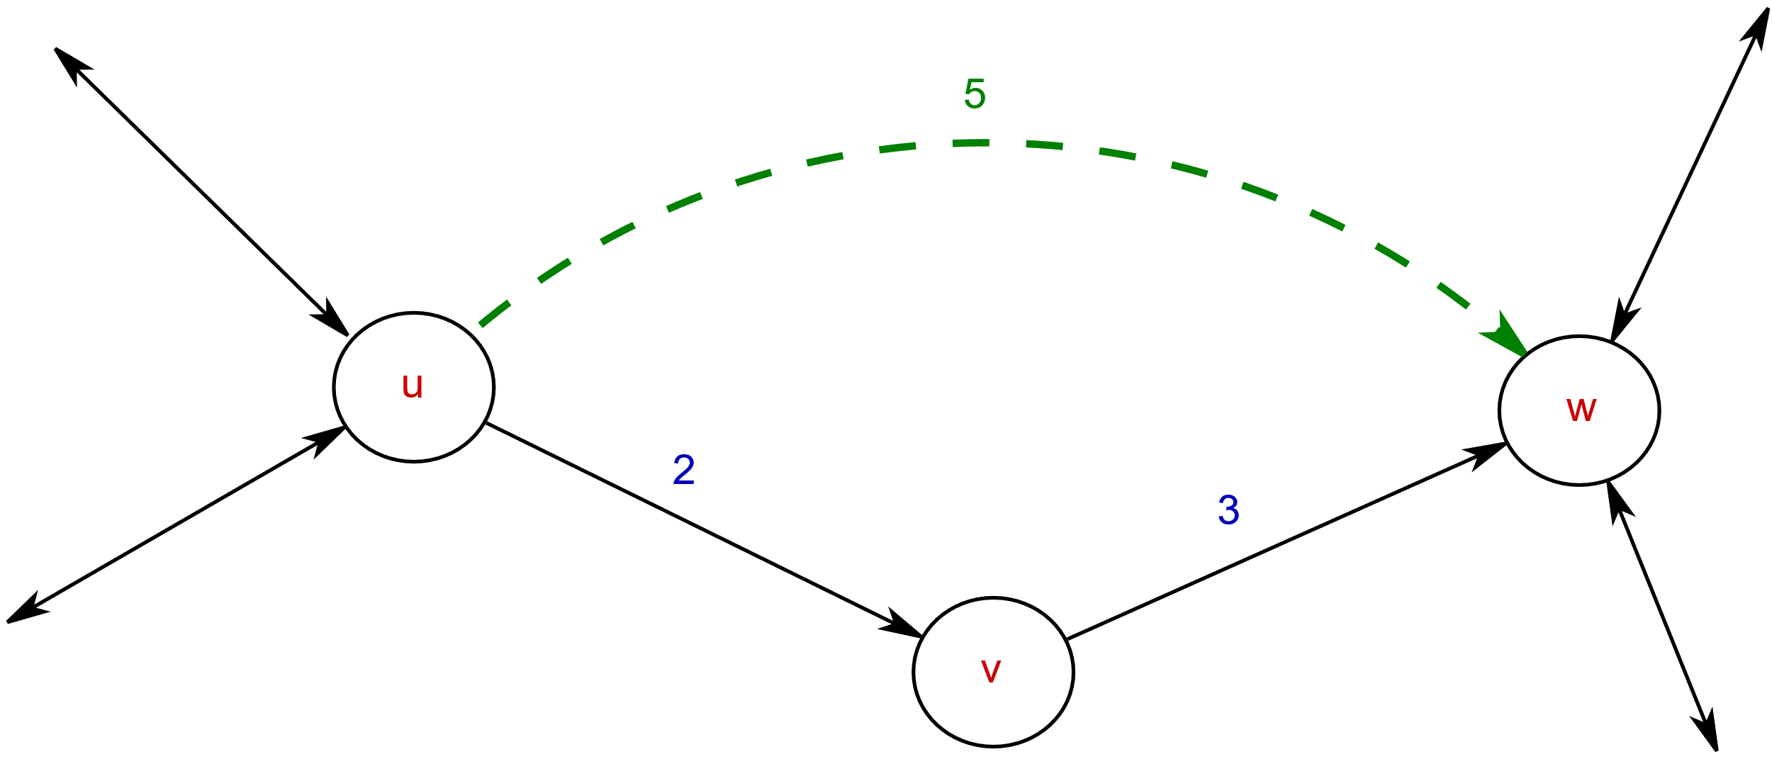
Contraction Hierarchies: Preprocessing
  Assign a scalar ‘importance’ to each vertex.
  Order the vertices in increasing order of ‘importance’.
  SHORTCUTS!
    If U->V->W
    is the shortest path
    from U to W,
    add a shortcut U -> W!
    (this is called the
    ‘contraction’
    operation)

Slide 27
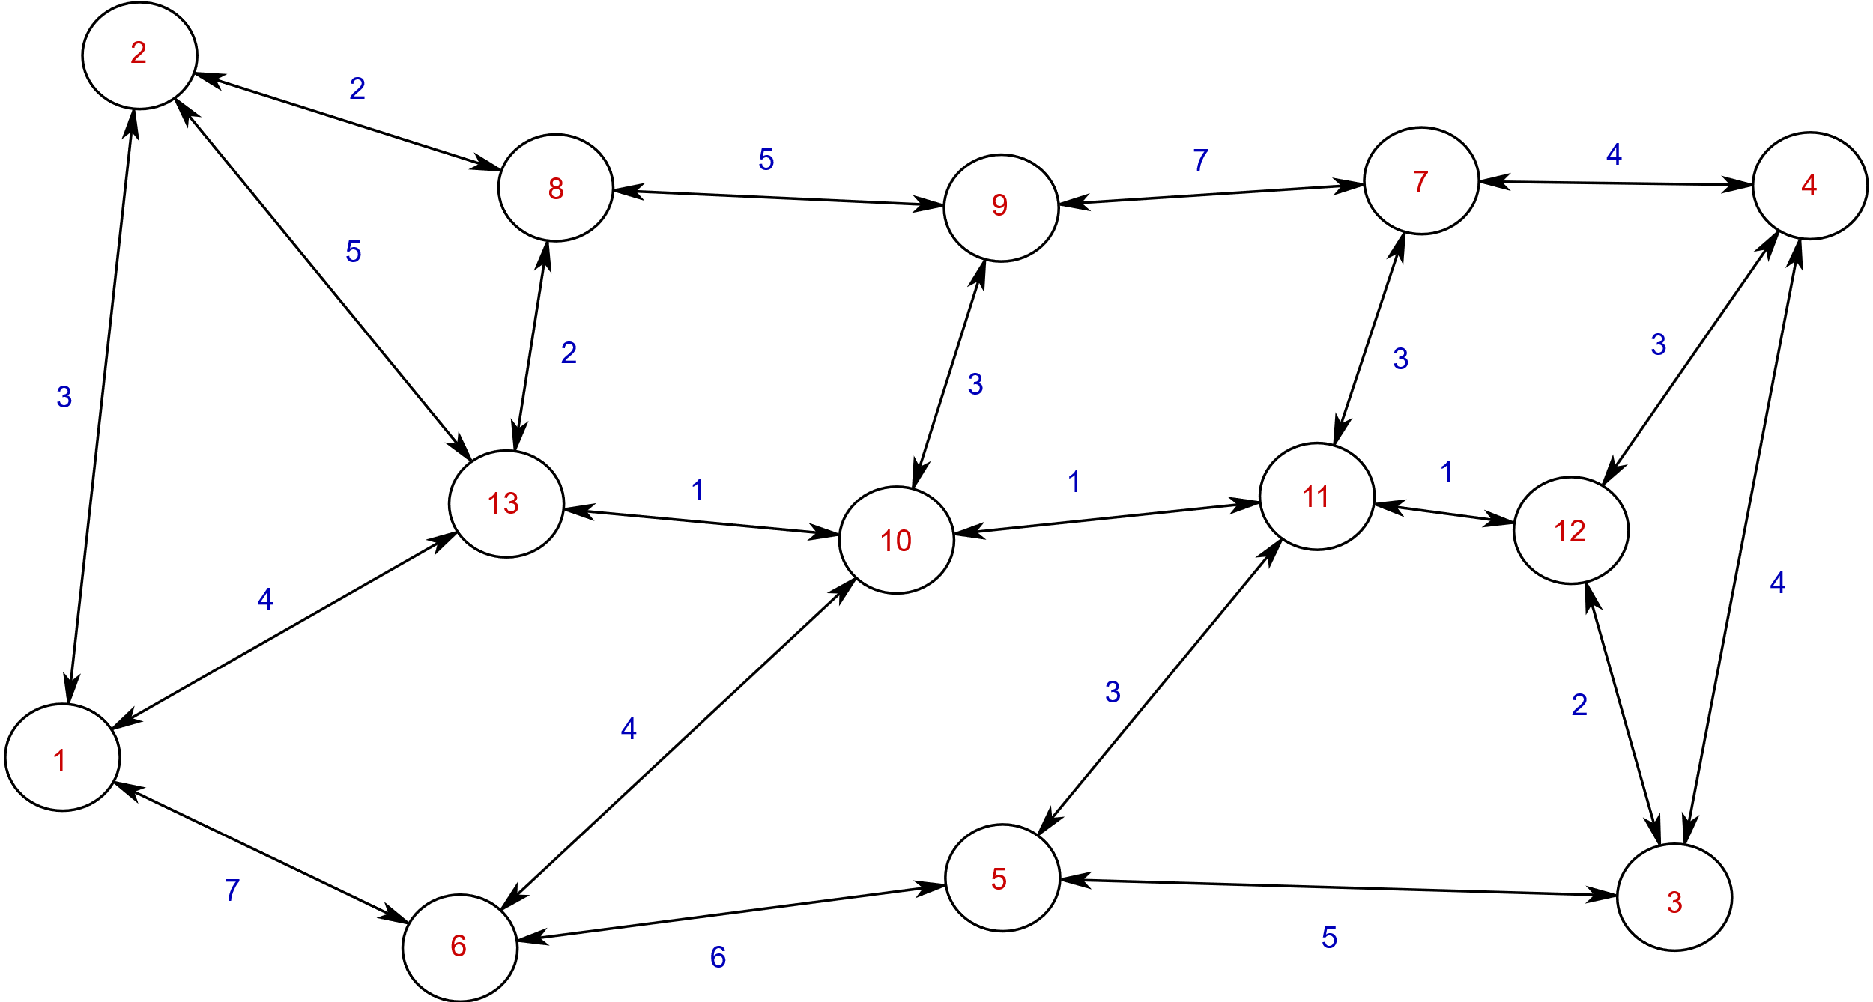

Slide 28
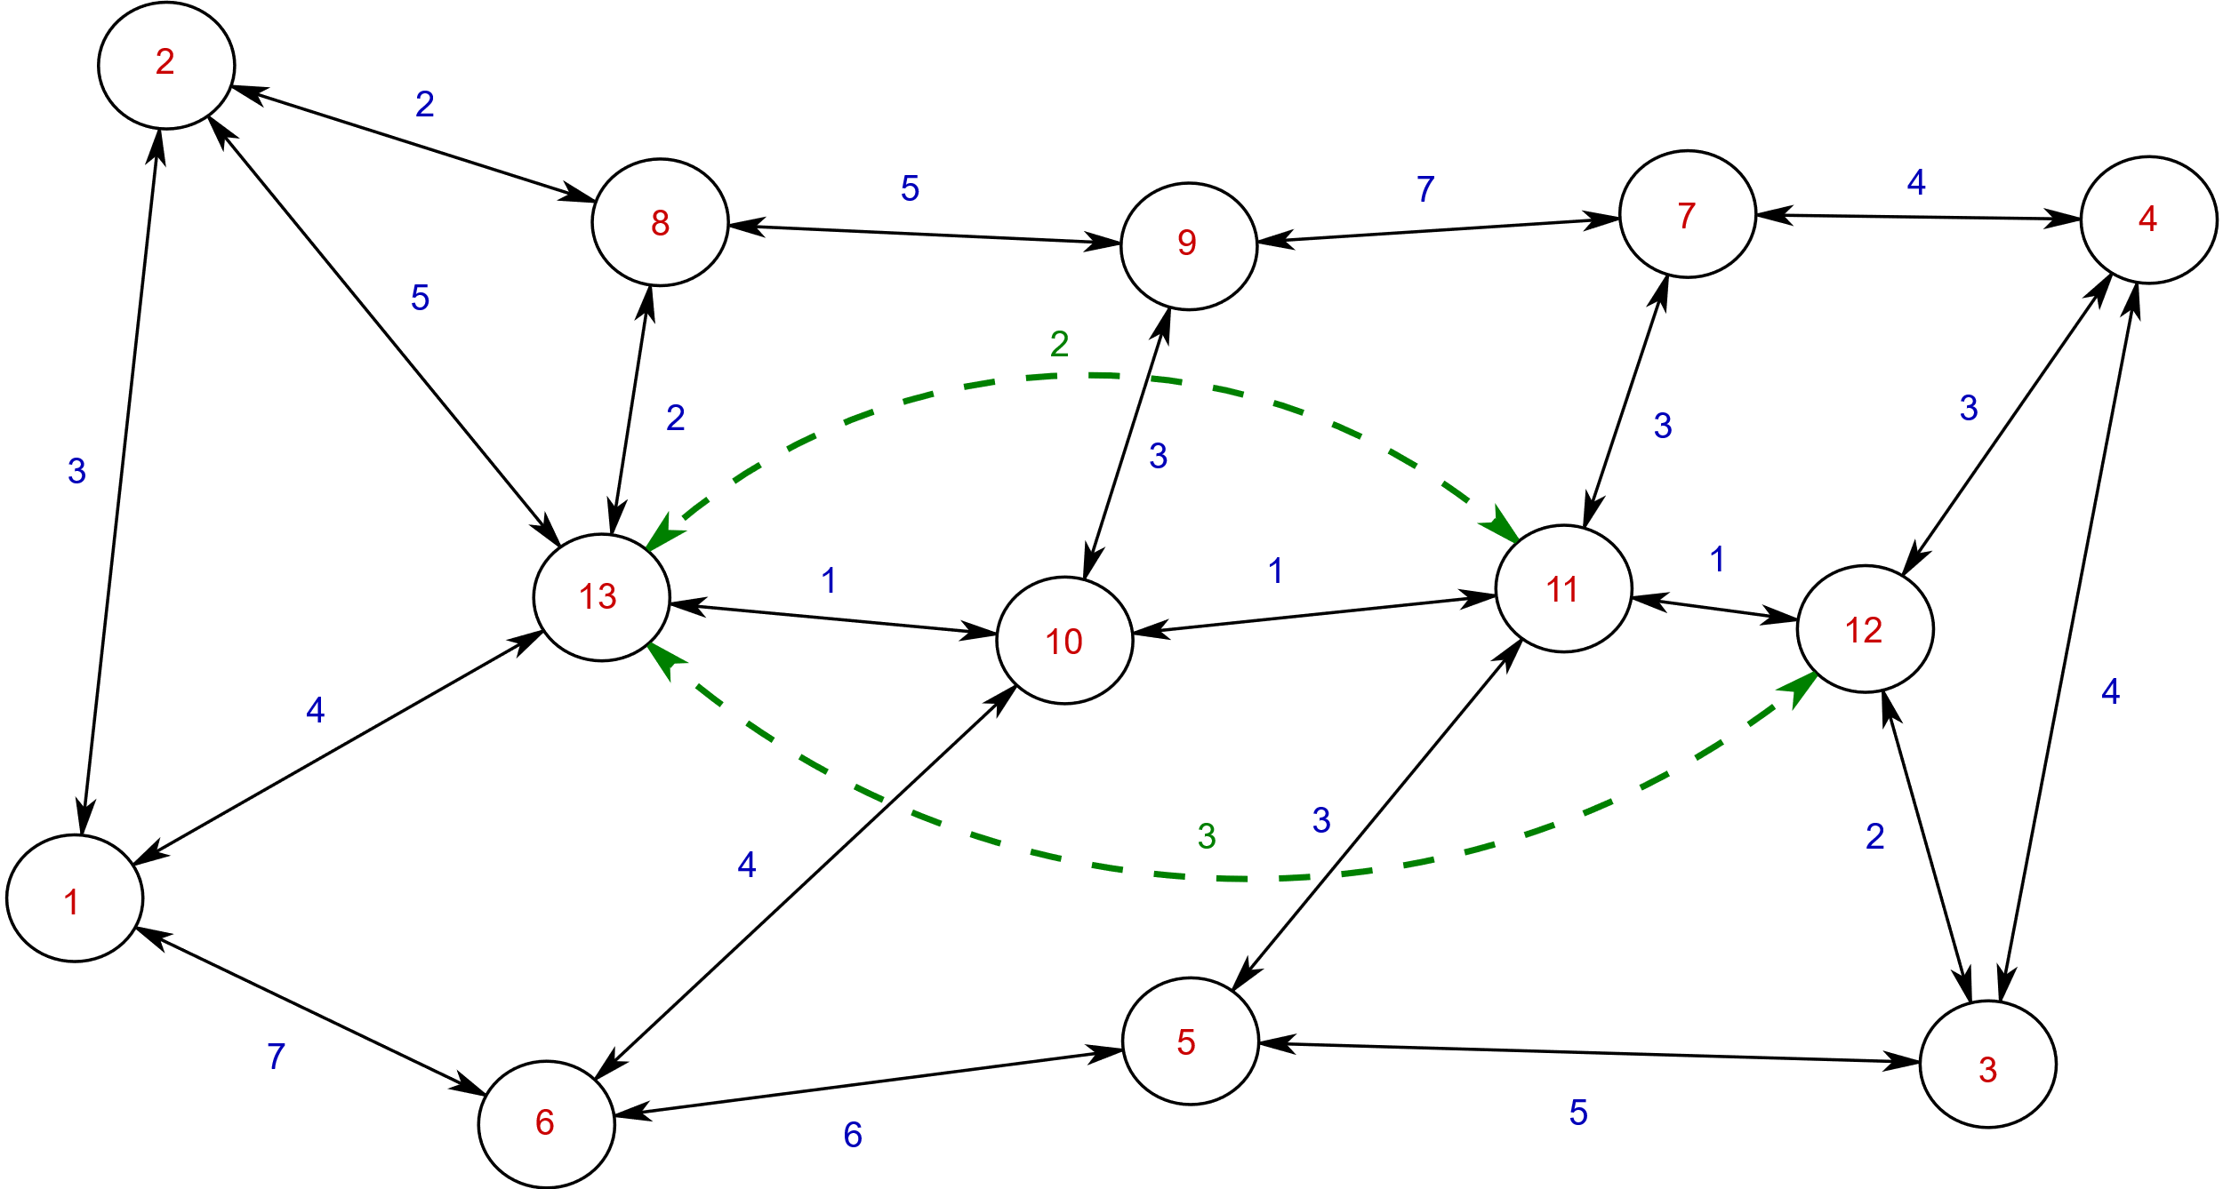

Slide 29
Counterintuitively:
We ADDED edges to the graph, and made it bigger… in order to compute shortest paths faster!

Slide 30
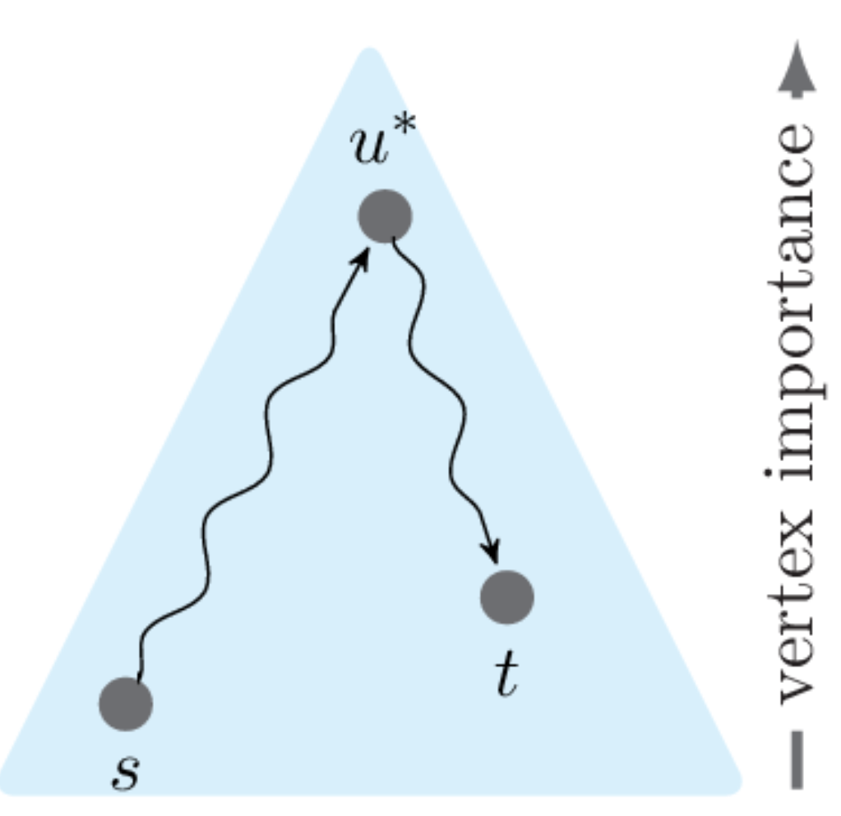
Contraction Hierarchies: Query
Image by Prof. Hannah Bast

Slide 31
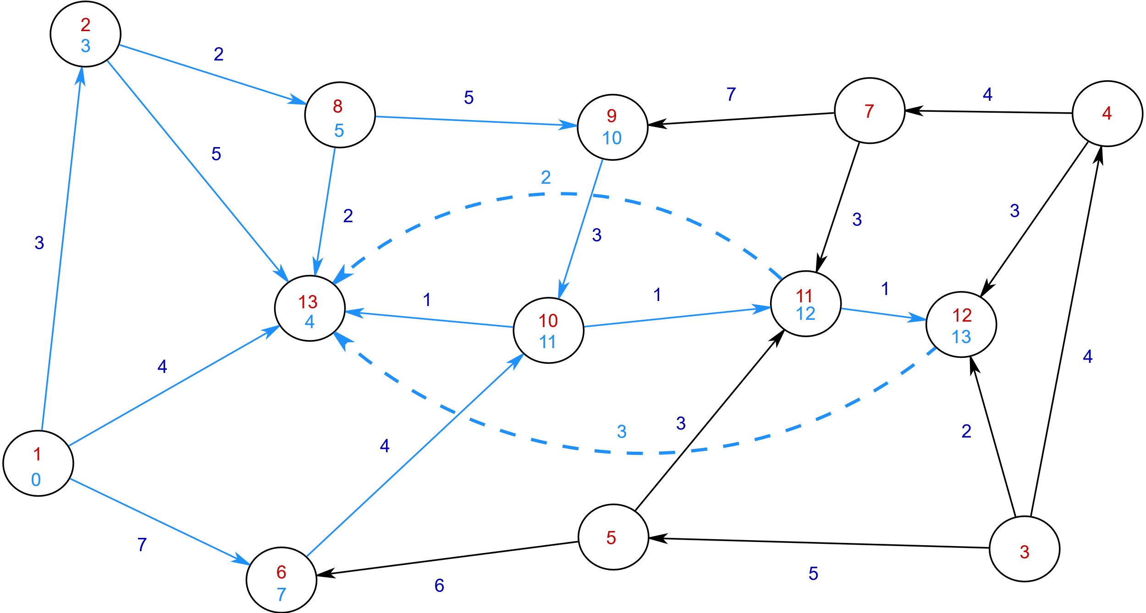

Slide 32
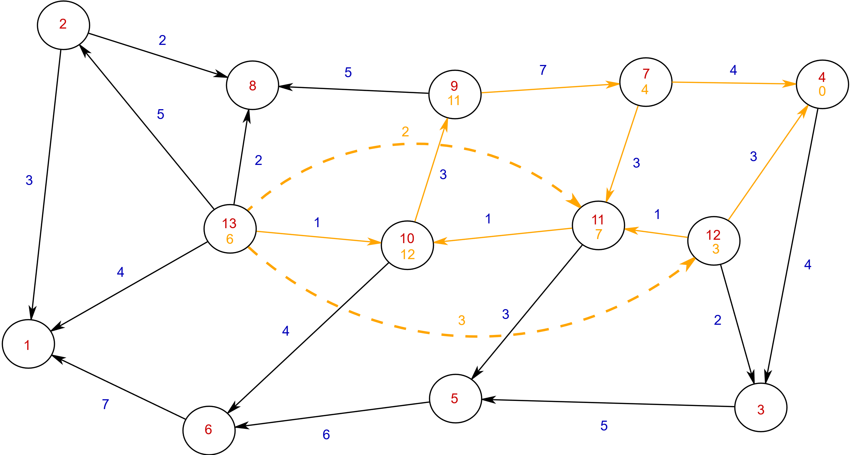

Slide 33
But what does all of this have to do with Rust?

Slide 34
C++!
  How do we represent graphs?
  A: Adjacency lists.

Slide 35
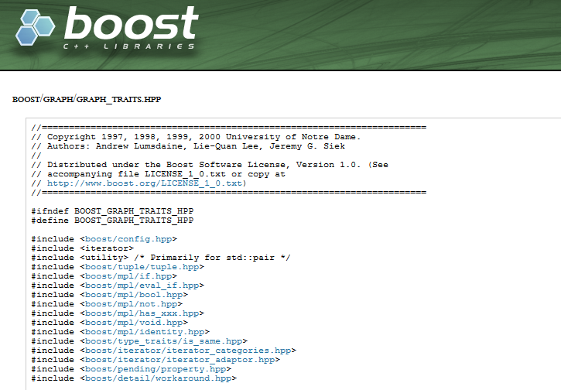
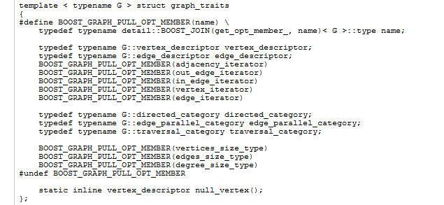
C++!
  How do we represent graphs?
  Adjacency lists.
  Let’s peek into the Boost Graph library.
  It is chock-full of traits!!

Slide 36
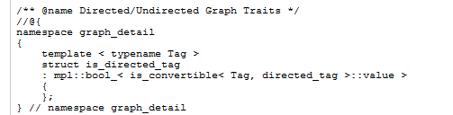
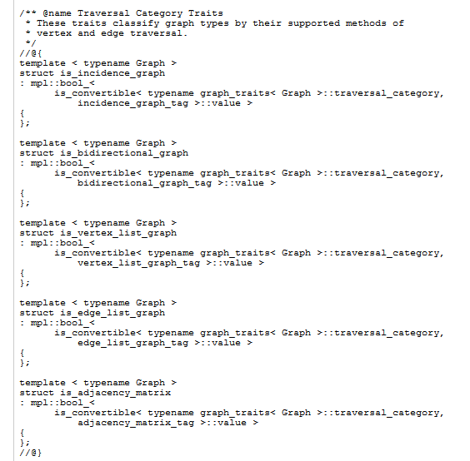
C++!
  How do we represent graphs?
  Adjacency lists.
  Let’s peek into the Boost Graph library.
  Traits are used to identify the operations allowed on different types of nodes, edges, edge weights, and graphs.

Slide 37
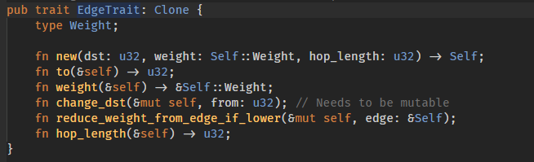
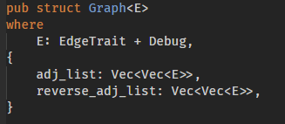
Rust!
  As opposed to C++, it is incredibly easy to use Rust for creating generic graph data structures!

Slide 38
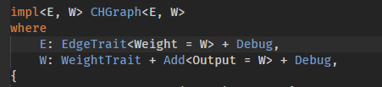
Rust!
  It is easy to require the Edge weight implement Add/Subtract/Multiply traits (operators +/-/*…),
  so nearly all generic algorithms can be reused for all weight types!
  (this is only available in Boost Concept Check library in C++).

Slide 39
Demo:
Contraction Hierarchies

Slide 40
References
Dr. Hannah Bast’s 2012 video lectures on route planning at the University of Freiburg.
(https://ad-wiki.informatik.uni-freiburg.de/teaching/EfficientRoutePlanningSS2012 )
Dr. Hannah Bast’s ICAPS 2018 keynote:
(https://www.youtube.com/watch?v=B3wKfJAVRkg )
Geisberger, Robert, et al.
"Contraction hierarchies: Faster and simpler hierarchical routing in road networks."
International Workshop on Experimental and Efficient Algorithms.
Springer, Berlin, Heidelberg, 2008.
Bast, Hannah, Delling, Daniel, Goldberg, Andrew et. al.
“Survey on Route Planning in Transportation Networks”,
(https://arxiv.org/pdf/1504.05140.pdf)

Slide 41
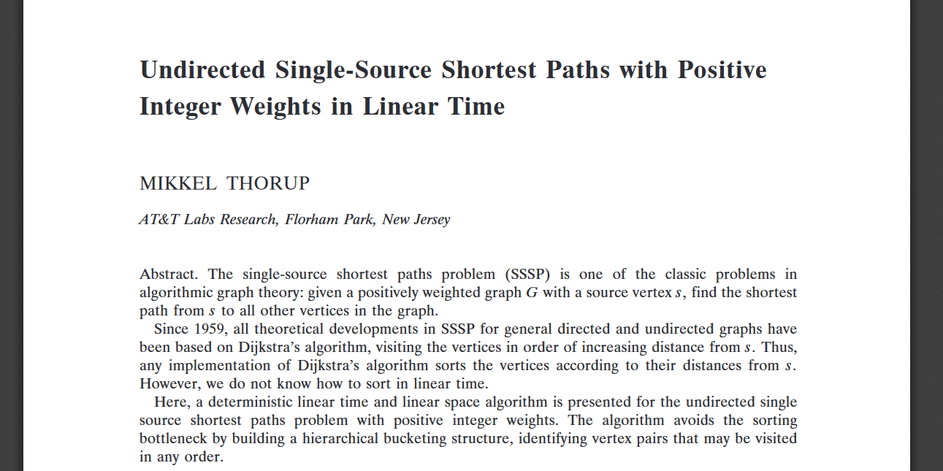
Linear time algorithm available*!
*In Theory

Slide 42
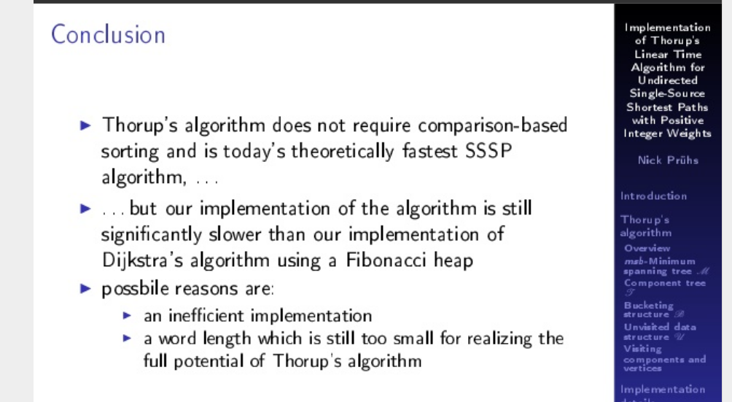
In 2014..

